Slide 1

Commission for Children and Young People Child Safe Standards Community of Practice
New Child Safe Standards resources for organisations

Slide 2
Housekeeping
This webinar will be recorded & published on our website.
Your camera & mic are disabled – We can’t see or hear you.
Please submit your questions via the Q&A function:
The slide pack, links to additional resources and a short feedback survey will be emailed to you after the session.

Slide 3
Agenda
Welcome
Pam Boag, Manager Education & Capacity Building
Opening remarks & Commission updates
Liana Buchanan, Principal Commissioner
Background & the Commission’s approach to regulating compliance with the new Standards
Emily Sanders, Director Regulation
Overview of the new A guide for creating a Child Safe Organisation
Alison Medhurst, Manager Policy Projects
Example: Compliance indicators for new Standard 4
Georgette Antonas, Principal Operational Policy Officer
Q&A with the Commission
Liana, Emily, Alison & Georgette
Closing remarks
Pam Boag, Manager Education & Capacity Building

Slide 4
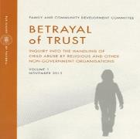


Background
Victorian review of
Child Safe Standards
completed
New
Child Safe Standards
in effect on 1 July 2022
Betrayal of Trust Inquiry conducted
Child Safe Standards commenced
2012
2013
2014
2015
2016
2017
2018
2019
2020
2021
2022
National Principles for Child Safe Organisations endorsed
New
Child Safe Standards announced
Royal Commission into Institutional Responses to Child Sexual Abuse conducted

Slide 5
The new Child Safe Standards
Standard 1
Organisations establish a culturally safe environment in which the diverse and unique identities of Aboriginal children and young people are respected and values
Standard 2
Child safety and wellbeing is embedded in organisational leadership, governance and culture
Standard 3
Children and young people are empowered about their rights, participate in decisions affecting them and are taken seriously
Standard 4
Families and communities are informed, and involved in promoting child safety and wellbeing
Standard 5
Equity is upheld and diverse needs respected in policy and practice
Standard 6
People working with children and young people are suitable and supported to reflect child safety and wellbeing values in practice
Standard 7
Processes for complaints and concerns are child focused
Standard 8
Staff and volunteers are equipped with the knowledge, skills and awareness to keep children and young people safe through ongoing education and training
Standard 9
Physical and online environments promote safety and wellbeing while minimising the opportunity for children and young people to be harmed
Standard 10
Implementation of the Child Safe Standards is regularly reviewed and improved
Standard 11
Policies and procedures document how the organisation is safe for children and young people

Slide 6
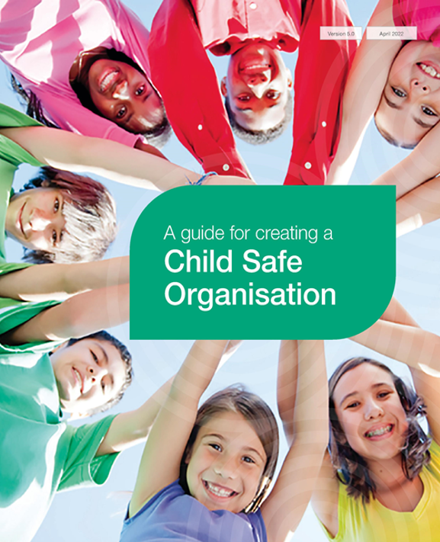


New resources

Slide 7





The Commission’s Regulatory Approach
From 1 July 2022, we will begin regulating compliance with the new Standards. Compliance with the previous Standards will no longer be assessed.
We will initially focus on informing and educating organisations about their obligations under the new Standards. However, there may be circumstances where we take other action, such as where serious safety risks to children and young people are identified.
From January 2023, we will expect organisations to have more comprehensively implemented the new Standards.

Slide 8
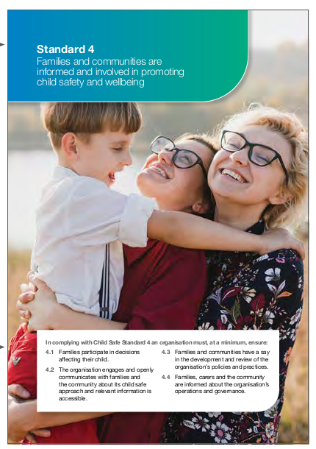
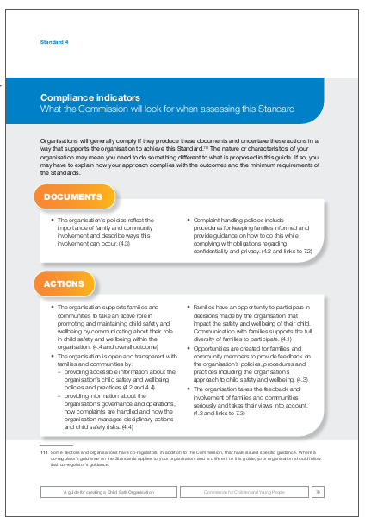
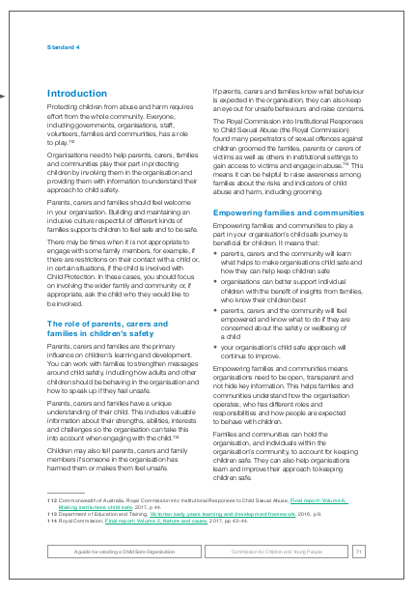
Overview of the new Guide
Outcome
Compliance Indicators
Minimum requirements
Advice and information

Slide 9
Compliance indicators for Standard 1
Child Safe Standard 1 – Organisations establish a culturally safe environment in which the diverse and unique identities and experiences of Aboriginal children and young people are respected and valued.
Foundation steps:
Starting point for organisations who are yet to make significant efforts towards establishing a culturally safe environment for Aboriginal children and young people.
Further steps:
Developed for organisations that believe they are well progressed in establishing a culturally safe environment for Aboriginal children and young people to build on the work already done.

Slide 10
Overview: New Child Safe Standard 4
Child Safe Standard 4 – Families and communities are informed and involved in promoting child safety and wellbeing
In complying with Child Safe Standard 4, an organisation must, at a minimum, ensure:
4.1 Families participate in decisions affecting their child.
4.2 The organisation engages and openly communicates with families and the community about its child safe approach and relevant information is accessible.
4.3 Families and communities have a say in the development and review of the organisation’s policies and practices.
4.4 Families, carers and the community are informed about the organisation’s operations and governance.

Slide 11
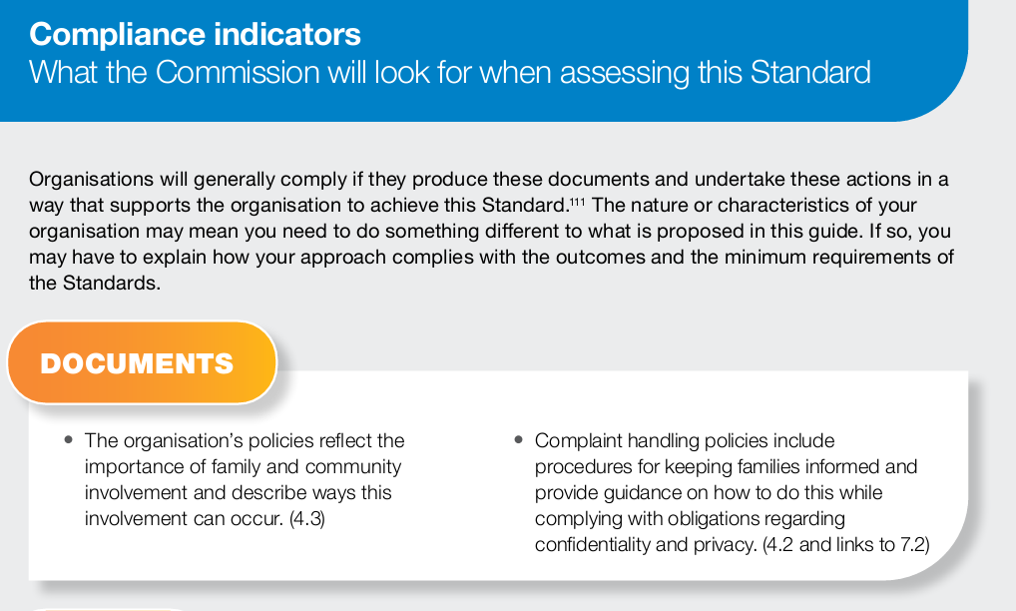
New Standard 4: Compliance indicators

Slide 12
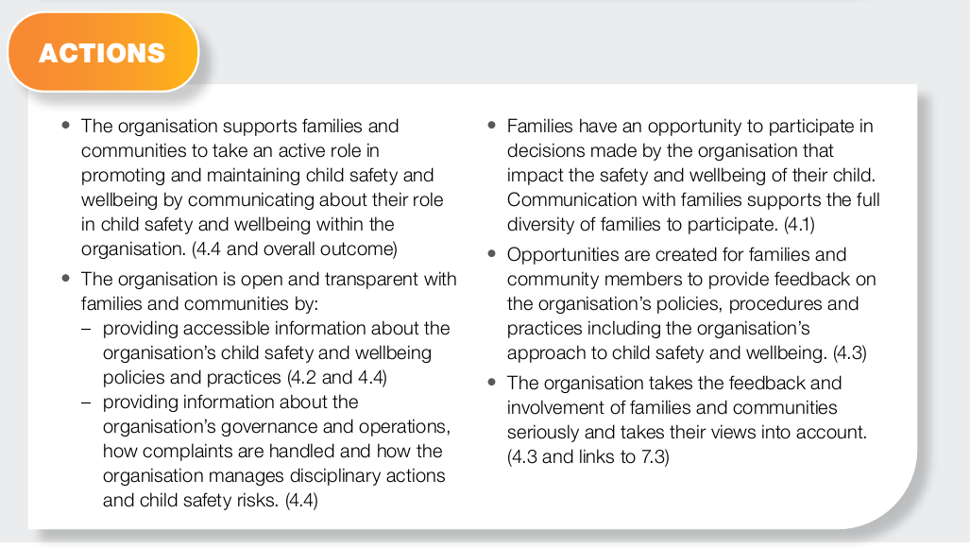
New Standard 4: Compliance indicators

Slide 13
New Standard 4: Information and Guidance
Information, guidance, tools, tips and resource
More detailed information about child safety and guidance about how to achieve compliance.
Barriers to participation by families and communities and how to overcome them.
Case study about listening and acting on the feedback of families and communities.
Suggested questions to help organisations plan engagement with families.
Links to additional resources, such as: Working with Aboriginal and Torres Strait Islander families and children toolkit, developed by the Emerging Minds: National Centre for Child Mental Health. Series of short videos focused on the experiences of newly arrived migrant families, published by the Raising Children’s Network. The Australian Human Rights Commission’s eLearning module on National Principle 3.

Slide 14
New Standard 4: Links to other Standards
1.4 The organisation actively supports and facilitates participation and inclusion within it by Aboriginal children, young people and their families.
1.5 All of the organisation’s policies, procedures, systems and processes together create a culturally safe and inclusive environment and meet the needs of Aboriginal children, young people and their families.
7.2 Effective complaint handling processes are understood by children and young people, families, staff and volunteers, and are culturally safe.
7.3 Complaints are taken seriously, and responded to promptly and thoroughly.
10.3 The organisation reports on the findings of relevant reviews to staff and volunteers, community and families and children and young people.

Slide 15
Questions submitted at registration for the Community of Practice
Emily Sanders, Director Regulation

Slide 16
Q&A with the Commission
Liana, Emily, Alison & Georgette
Notes:
Frequently asked questions (FAQs) – New Child Safe Standards: https://ccyp.vic.gov.au/assets/resources/New-Standards/New-Child-Safe-Standards-frequently-asked-questions.pdf

Slide 17
Useful resources
Recently published:
Short guide to the Child Safe Standards
A guide for creating a Child Safe Organisation
Tools and templates
Coming soon:
Introductory on-demand webinar for the new Child Safe Standards
Further guidance on creating a culturally safe environment for Aboriginal children and young people

Slide 18
Where to go for more information
You can contact the Commission with questions or queries:
 Telephone: 1300 782 978 or (03) 8601 5281
 Email: contact@ccyp.vic.gov.au
 Visit the Commission’s website: www.ccyp.vic.gov.au
Sign up to receive Commission updates
https://ccyp.vic.gov.au/contact-us/sign-up-for-commission-updates/

